Slide 1
Relationships within Triangles
Geometry
Chapter 5
Notes:
Geometry 5

Slide 2
This Slideshow was developed to accompany the textbook
  Larson Geometry
  By Larson, R., Boswell, L., Kanold, T. D., & Stiff, L.
  2011 Holt McDougal
Some examples and diagrams are taken from the textbook.
Slides created by
Richard Wright, Andrews Academy
rwright@andrews.edu

Slide 3
5.1 Midsegment Theorem and Coordinate Proof
Draw a triangle in your notes
Find the midpoints of two of the sides using a ruler
Connect the midpoints of the two sides with a segment
Measure the segment and the third side
What do you notice?
What else do you notice about those two segments?
Notes:
Length should be ½
They should be parallel

Slide 4
5.1 Midsegment Theorem and Coordinate Proof
Midsegment of a Triangle
  Segment that connects the midpoints of two sides of a triangle
Midsegment Theorem
The midsegment of a triangle is parallel to the third side and is half as long as that side.

Slide 5
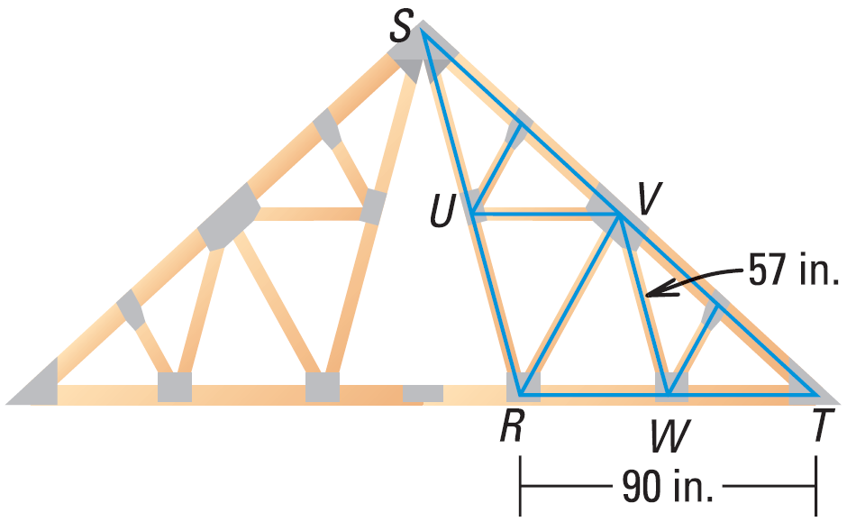
5.1 Midsegment Theorem and Coordinate Proof
Name the midsegments.
Draw the third midsegment.
Let UW be 81 inches. Find VS.
Notes:
UV, WV
UW
UW = ½ ST
VT = ½ ST
UW = VT = 81

Slide 6
5.1 Midsegment Theorem and Coordinate Proof
Coordinate Proof
Use the origin as a vertex or center.
Place at least one side of the polygon on an axis.
Usually keep the figure within the first quadrant.
Use coordinates that make computations as simple as possible.
You will prove things by calculating things like slope, distance, and midpoints

Slide 7
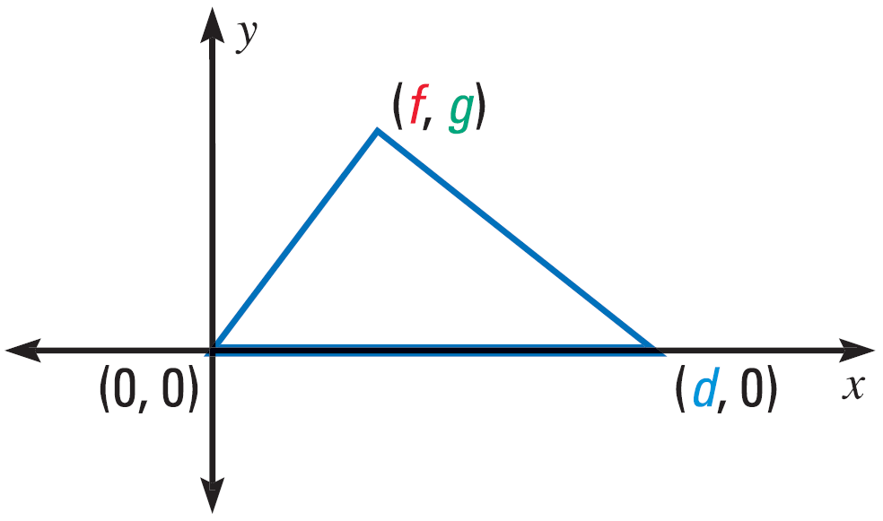
5.1 Midsegment Theorem and Coordinate Proof

Slide 8
5.1 Midsegment Theorem and Coordinate Proof
(0, a)
(a, a)
Place a square in a coordinate plane so that it is convenient for finding side lengths. Assign coordinates.
Place a right triangle in a coordinate plane so that it is convenient for finding side lengths. Assign coordinates.
(0, 0)
(a, 0)
(0, b)
(0, 0)
(a, 0)

Slide 9
5.1 Midsegment Theorem and Coordinate Proof
Write a coordinate proof of the midsegment theorem.
Draw the figure
Draw a midsegment.
Calculate the proof
  Lines are parallel
  Midsegment = ½ third side
(2b, 2c)
(a+b, c)
(0, 0)
(a, 0)
(2a, 0)
Notes:
Since we’re finding midpoints, it is convenient to use 2a, 2b, and 2c so that the midpoints are whole numbers.
Midpoint calculations:
midpoint = ((x₁ + x₂)/2, (y₁ + y₂)/2)
((0 + 2a)/2, (0 + 0)/2) = (a, 0)
((2a + 2b)/2, (0 + 2c)/2) = (a + b, c)
Parallel calculations:
slope = (y₂ – y₁)/(x₂ – x₁)
m = (2c – 0)/(2b – 0) = c/b
m = (c – 0)/(a+b – a) = c/b
slopes are the same so lines are parallel
Length calculation:
dist = √((x₂ – x₁)² + (y₂ – y₁)²)
√((2b – 0)² + (2c – 0)²) = √(4b² + 4c²) = √(4(b² + c²)) = 2√(b² + c²)
√((a+b – a)² + (c – 0)²) = √(b² + c²)

Slide 10
5.1 Midsegment Theorem and Coordinate Proof
298 #2-18 even, 24-32 even, 36, 40, 42, 44, 48-52 even = 21 total

Slide 11
5.1 Answers and Quiz
5.1 Answers
5.1 Quiz

Slide 12
5.2 Use Perpendicular Bisectors
Perpendicular Bisector
  Segment that is perpendicular to and bisects a segment
Perpendicular Bisector Theorem
If a point is on the perpendicular bisector of a segment, then it is equidistant from the endpoints of the segment
Converse of the Perpendicular Bisector Theorem
If a point is equidistant from the endpoints of a segment, then it is on the perpendicular bisector of the segment

Slide 13
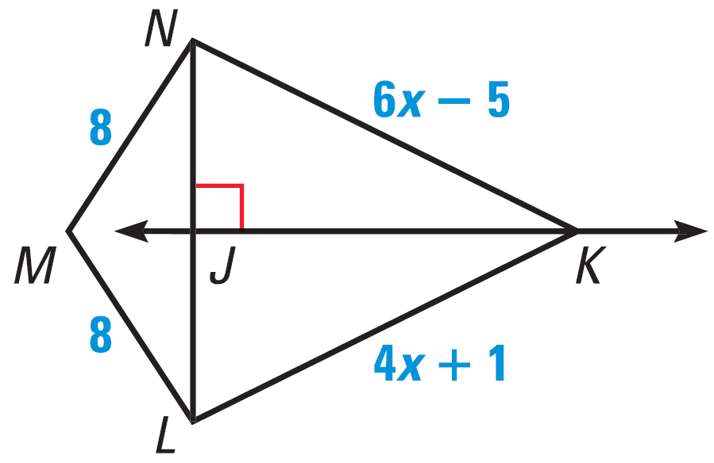
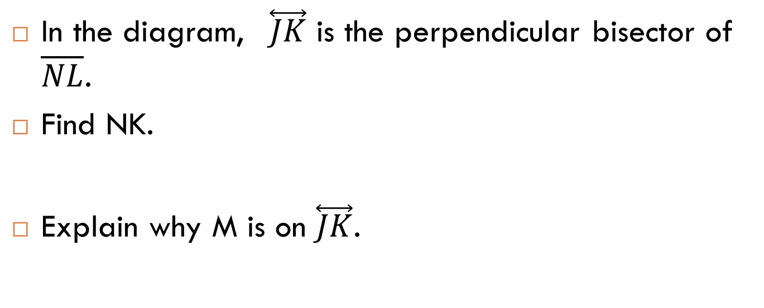
5.2 Use Perpendicular Bisectors
In the diagram, $\overset{⃡}{JK}$ is the perpendicular bisector of $\overline{NL}$.
Find NK.
Explain why M is on $\overset{⃡}{JK}$.
Notes:
Since JK is ⊥ bisector, then NK = LK (⊥ bisector theorem).
6x – 5 = 4x + 1 → 2x – 5 = 1 → 2x = 6 → x = 3
Find NK: 6x – 5 → 6(3) – 5 = 13
Since MN = ML, M is equidistant from each end of NL. Thus by then Converse of the Perpendicular Bisector Theorem, M is on the perpendicular bisector.

Slide 14
5.2 Use Perpendicular Bisectors
Find the perpendicular bisectors of a triangle
Cut out a triangle
Fold each vertex to each other vertex
  The three folds are the perpendicular bisectors
What do you notice?
  Perpendicular bisectors meet at one point
Measure the distance from the meeting point to each vertex
What do you notice?
  The distances are equal

Slide 15
5.2 Use Perpendicular Bisectors
Concurrent
  Several lines that intersect at same point (point of concurrency)
Concurrency of Perpendicular Bisectors of a Triangle
The perpendicular bisectors of a triangle intersect at a point that is equidistant from the vertices of a triangle

Slide 16
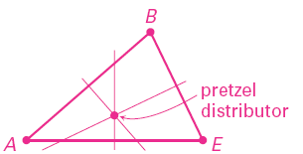
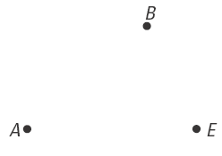
5.2 Use Perpendicular Bisectors
Hot pretzels are sold from store at A, B, and E. Where could the pretzel distributor be located if it is equidistant from those three points?

Slide 17
5.2 Use Perpendicular Bisectors
Circumcenter
  The point of concurrency of the perpendicular bisectors of a triangle.
  If a circle was circumscribed around a triangle, the circumcenter would also be the center of the circle.

Slide 18
5.2 Use Perpendicular Bisectors
306 #2-16 even, 20, 22, 26, 28, 30, 34-40 even = 17 total
Extra Credit 309 #2, 4 = +2

Slide 19
5.2 Answers and Quiz
5.2 Answers
5.2 Quiz

Slide 20
5.3 Use Angle Bisectors of Triangles
Angle Bisector
  Ray that bisects an angle
Angle Bisector Theorem
If a point is on the angle bisector, then it is equidistant from the sides of the angle
Converse of the Angle Bisector Theorem
If a point is equidistant from the sides of an angle, then it is on the angle bisector

Slide 21
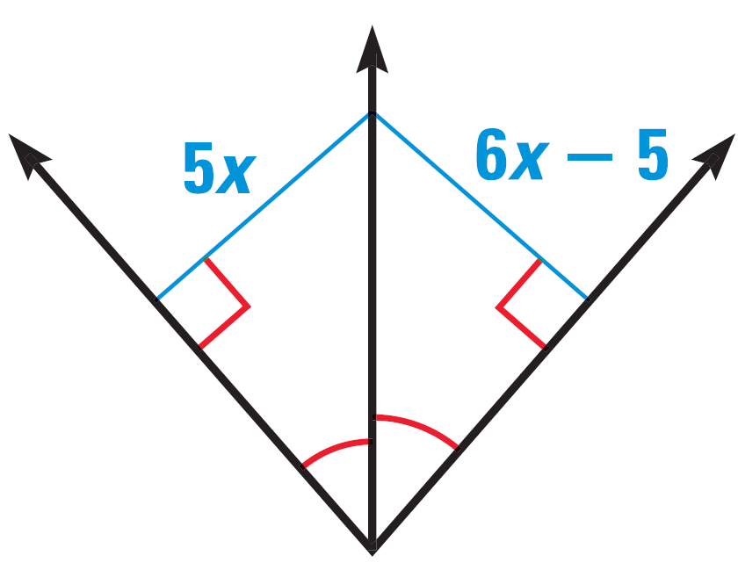
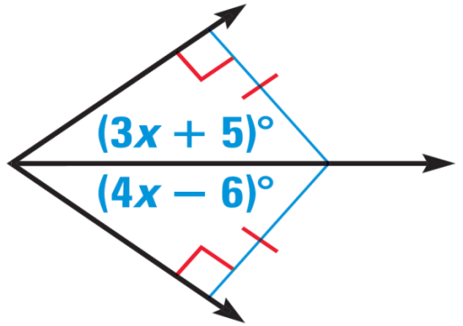
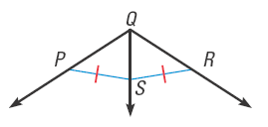

5.3 Use Angle Bisectors of Triangles
Find the value of x.
Do you have enough information to conclude that $\vec{QS}$ bisects ∠PQR?
Notes:
3x + 5 = 4x – 6 → 5 = x – 6 → x = 11
5x = 6x – 5 → -x = -5 → x = 5
No, you need to know that SP ⊥ QP and SR ⊥ QR

Slide 22
5.3 Use Angle Bisectors of Triangles
Concurrency of Angle Bisectors of a Triangle
The angle bisectors of a triangle intersect at a point that is equidistant from the sides of a triangle
Incenter
  Point of concurrency of the angle bisectors of a triangle
  If a circle was inscribed in a triangle, the incenter would also be the center of the circle.

Slide 23
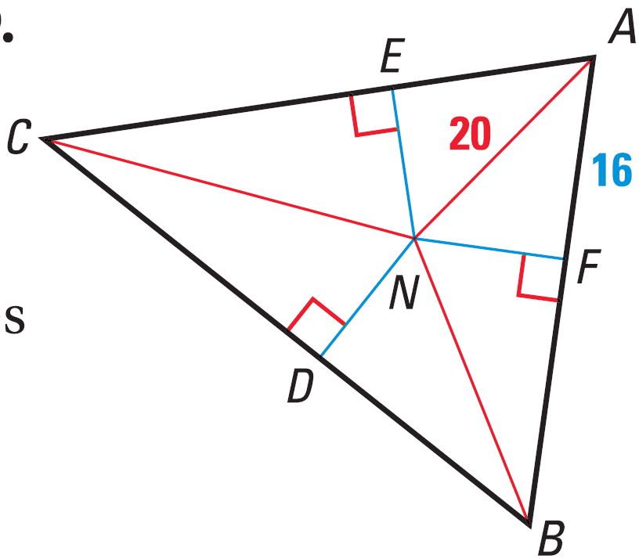
5.3 Use Angle Bisectors of Triangles
N is the incenter. Find EN.
313 #2-24 even, 30, 34, 40-46 even = 18 total
Notes:
Find NF by using the Pythagorean theorem.
16² + NF² = 20² → 256 + NF² = 400 → NF² = 144 → NF = 12
Since N is the incenter, NF = EN = 12

Slide 24
5.3 Answers and Quiz
5.3 Answers
5.3 Quiz

Slide 25
5.4 Use Medians and Altitudes
Median
  Segment that connects a vertex to a midpoint of side of a triangle.
  Point of concurrency is called the centroid.
  The centroid is the balance point.
Concurrency of Medians of a Triangle
The medians of a triangle intersect at a point that is two thirds of the distance from each vertex to the midpoints of the opposite side.

Slide 26
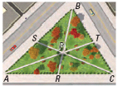
5.4 Use Medians and Altitudes
Each path goes from the midpoint of one edge to the opposite corner. The paths meet at P.
If SC = 2100 ft, find PS and PC.
If BT = 1000 ft, find TC and BC.
If PT = 800 ft, find PA and TA.
Notes:
PC = 2/3 SC → PC = 2/3 (2100) = 1400 ft → PS = 700 ft
T is midpoint of BC. TC = 1000 ft, BC = 2000 ft
PT = 1/3 TA → 800 = 1/3 TA → 2400 ft = TA, PA = 1600 ft

Slide 27
5.4 Use Medians and Altitudes
Altitudes
  Segment from a vertex and perpendicular to the opposite side of a triangle.
  Point of concurrency is called the orthocenter.
Concurrency of Altitudes of a Triangle
The lines containing the altitudes of a triangle are concurrent.
Notes:
There is nothing terribly interesting about the orthocenter.
In an acute triangle, the orthocenter is inside the triangle.
In a right triangle, the orthocenter is on the triangle at the right angle.
In an obtuse triangle, the orthocenter is outside of the triangle.

Slide 28
5.4 Use Medians and Altitudes
In an isosceles triangle, the perpendicular bisector, angle bisector, median, and altitude from the vertex angle are all the same segment.

Slide 29
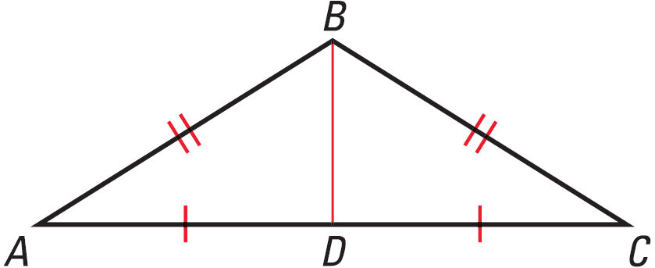
5.4 Use Medians and Altitudes
Find the orthocenter.
Notes:
Draw the other two altitudes (from A and C). They will be outside the triangle.
OQ is also the perpendicular bisector, angle bisector, and median.
P (-h, 0)

Slide 30
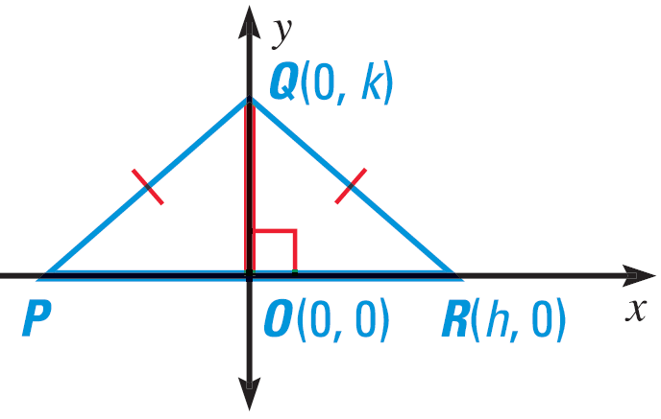

5.4 Use Medians and Altitudes
ΔPQR is isosceles and segment $\overline{OQ}$ is an altitude. What else do you know about $\overline{OQ}$? What are the coordinates of P?
Notes:
Draw the other two altitudes (from A and C). They will be outside the triangle.
OQ is also the perpendicular bisector, angle bisector, and median.
P (-h, 0)

Slide 31

5.4 Use Medians and Altitudes
Given: ΔABC is isosceles, $\overline{BD}$ is a median
Prove: $\overline{BD}$ is an angle bisector
Statements
Reasons
Notes:
ΔABC is isosceles, BD is a median (given)
BA ≅ BC (def. Isosceles)
AD ≅ DC (def. Median)
BD ≅ BD (reflexive)
ΔABD ≅ ΔCBD (SSS)
∠ABD ≅ ∠CBD (def ≅ Δ) (CPCTC)
BD is an angle bisector (def angle bisector)

Slide 32
5.4 Use Medians and Altitudes
322 #2-26 even, 34, 40, 42, 46-54 even = 20 total
Extra Credit 325 #2, 4 = +2

Slide 33
5.4 Answers and Quiz
5.4 Answers
5.4 Quiz

Slide 34
5.5 Use Inequalities in a Triangle
Draw a scalene triangle
Measure the sides
Measure the angles
What do you notice?
  Smallest side opposite _________
  Largest angle opposite __________
Notes:
Smallest angle
Largest side

Slide 35
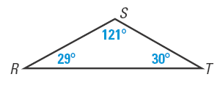
5.5 Use Inequalities in a Triangle
If one side of a triangle is longer than another side, then the angle opposite the longer side is larger than the angle opposite the shorter side.
If one angle of a triangle is larger than another angle, then the side opposite the larger angle is longer than the side opposite the smaller angle.
List the sides in order from shortest to longest.
Notes:
ST, RS, RT

Slide 36
5.5 Use Inequalities in a Triangle
Draw a triangle with sides 5 cm, 2 cm, and 2 cm.
Draw a triangle with sides 5 cm, 2 cm, and 3 cm.
Draw a triangle with sides 5 cm, 3 cm, and 3 cm.
Triangle Inequality Theorem
The sum of two sides of a triangle is greater than the length of the third side.
AB + BC > AC; AB + AC > BC; BC + AC > AB
Notes:
Can’t be done, short side don’t touch
Can’t be done, forms a line
Can be done, isosceles triangle

Slide 37
5.5 Use Inequalities in a Triangle
A triangle has one side of 11 inches and another of 15 inches. Describe the possible lengths of the third side.
Notes:
11 + x > 15 → x > 4
15 + x > 11 → x > -4 (not useful)
11 + 15 > x → 26 > x
Combine 1st and 3rd: 4 < x < 26
Short cut: subtract to get smallest, add to get largest

Slide 38
5.5 Use Inequalities in a Triangle
Find all possible values of x.
331 #2, 6-34 even, 40-44 even, 49, 52, 54 = 22 total
2X + 10
X + 11
5X – 9
Notes:
x + 11 + 2x + 10 > 5x – 9 → 3x + 21 > 5x – 9 → 30 > 2x → 15 > x
2x + 10 + 5x – 9 > x + 11 → 7x + 1 > x + 11 → 6x > 10 → x > 10/6 → x > 1 2/3
x + 11 + 5x – 9 > 2x + 10 → 6x + 2 > 2x + 10 → 4x > 8 → x > 2
Choose narrowest interval: 2 < x < 15

Slide 39
5.5 Answers and Quiz
5.5 Answers
5.5 Quiz

Slide 40
5.6 Inequalities in Two Triangles and Indirect Proof
See Mr. Wright’s demonstration with the metersticks.
How does the third side compare when there is a small angle to a big angle?
Notes:
Use two meter sticks to demonstrate the SAS Inequality and SSS Inequality
Have two meter sticks form two sides of the Δ and have the kids imagine the third side.

Slide 41
5.6 Inequalities in Two Triangles and Indirect Proof
Hinge Theorem
If 2 sides of one Δ are congruent to 2 sides of another Δ, and the included angle of the 1st Δ is larger than the included angle of the 2nd Δ, then the 3rd side of the 1st Δ is longer than the 3rd side of the 2nd Δ.
10
15
40°
60°

Slide 42
5.6 Inequalities in Two Triangles and Indirect Proof
Converse of the Hinge Theorem
If 2 sides of one Δ are congruent to 2 sides of another Δ, and the 3rd side of the first is longer than the 3rd side of the 2nd Δ, then the included angle of the 1st Δ is larger than the included angle of the 2nd Δ.
10
15
40°
60°

Slide 43
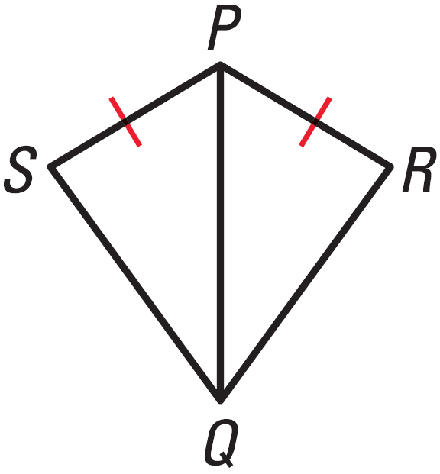
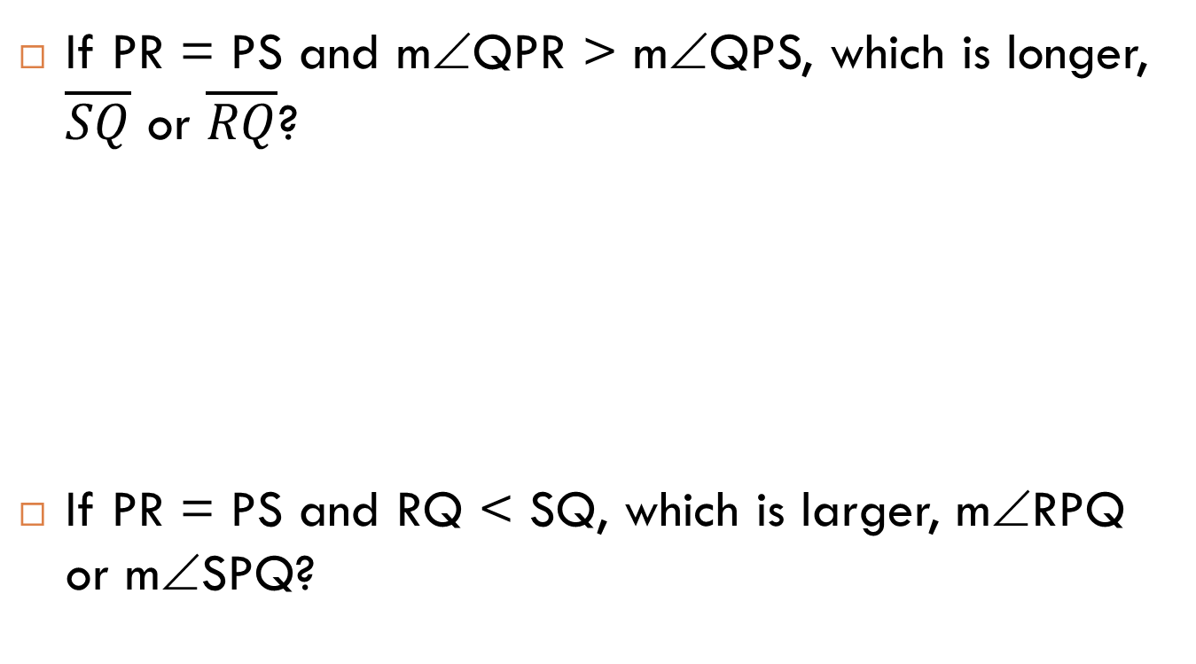
5.6 Inequalities in Two Triangles and Indirect Proof
If PR = PS and m∠QPR > m∠QPS, which is longer, $\overline{SQ}$ or $\overline{RQ}$?
If PR = PS and RQ < SQ, which is larger, m∠RPQ or m∠SPQ?

Slide 44
5.6 Inequalities in Two Triangles and Indirect Proof
Indirect Reasoning
  You are taking a multiple choice test.
  You don’t know the correct answer.
  You eliminate the answers you know are incorrect.
  The answer that is left is the correct answer.
You can use the same type of logic to prove geometric things.

Slide 45
5.6 Inequalities in Two Triangles and Indirect Proof
Indirect Proof
  Proving things by making an assumption and showing that the assumption leads to a contradiction.
  Essentially it is proof by eliminating all the other possibilities.

Slide 46
5.6 Inequalities in Two Triangles and Indirect Proof
Steps for writing indirect proofs
  Identify what you are trying to prove. Temporarily, assume the conclusion is false and that the opposite is true.
  Show that this leads to a contradiction of the hypothesis or some other fact.
  Point out that the assumption must be false, so the conclusion must be true.

Slide 47
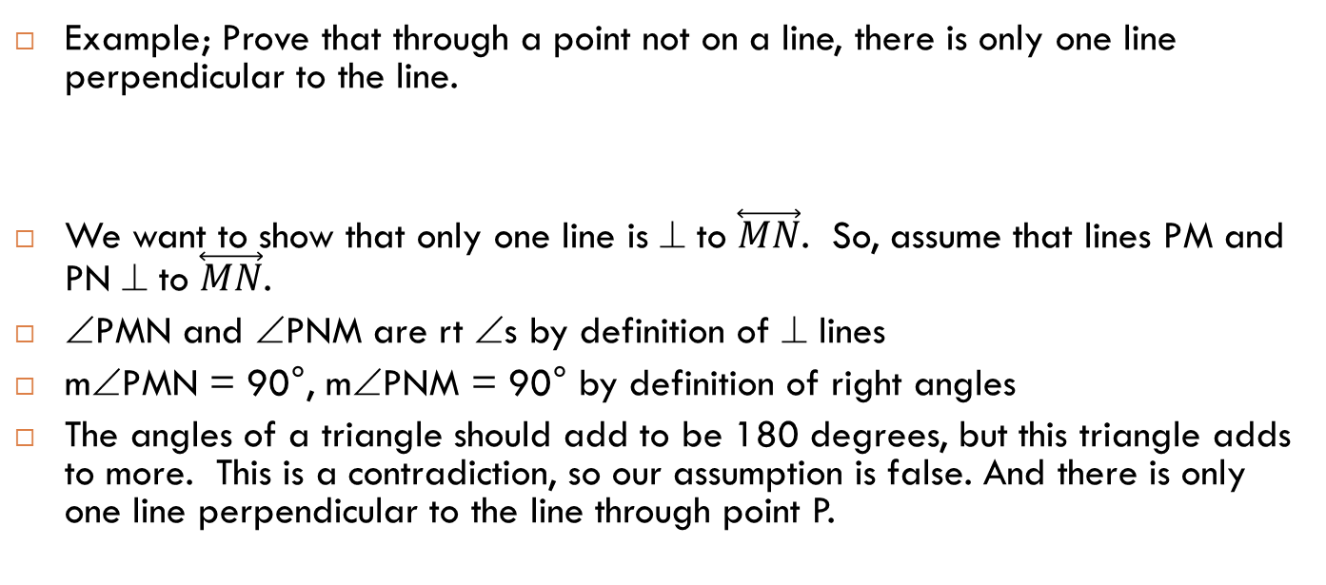
5.6 Inequalities in Two Triangles and Indirect Proof
Example; Prove that through a point not on a line, there is only one line perpendicular to the line.
We want to show that only one line is ⊥ to $\overset{⃡}{MN}$. So, assume that lines PM and PN ⊥ to $\overset{⃡}{MN}$.
∠PMN and ∠PNM are rt ∠s by definition of ⊥ lines
m∠PMN = 90°, m∠PNM = 90° by definition of right angles
The angles of a triangle should add to be 180 degrees, but this triangle adds to more. This is a contradiction, so our assumption is false. And there is only one line perpendicular to the line through point P.
P
M
N

Slide 48
5.6 Inequalities in Two Triangles and Indirect Proof
Suppose you wanted to prove the statement “If x + y ≠ 14 and y = 5, then x ≠ 9.” What temporary assumption could you make to prove the conclusion indirectly?
How does that assumption lead to a contradiction?
Notes:
Assume x = 9
If x = 9, then x + y ≠ 14. 9 + 5 ≠ 14 → 14 ≠ 14. This is the contradiction

Slide 49
5.6 Inequalities in Two Triangles and Indirect Proof
338 #4-18 even, 22-34 even = 15 total
Extra Credit 341 #2, 4 = +2

Slide 50
5.6 Answers and Quiz
5.6 Answers
5.6 Quiz

Slide 51
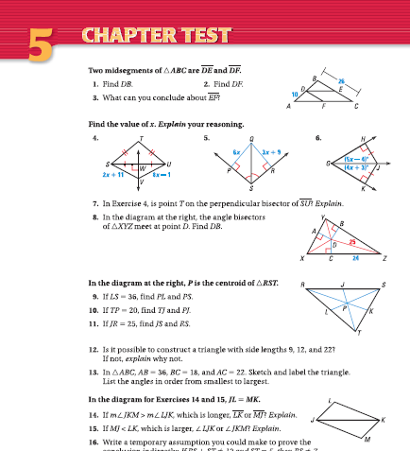
5.Review
348 #1-18 = 18 total

